Slide 1

Website Usability
Year 10 Web design

Slide 2
What makes a website good?
A website is good if it is useable. But how can we measure if a website is useable or not?
We can use a guide, a rule of thumb, a heuristic.
Neilson's 10 Heuristics are the gold standard measure if a website is useable or not.

Slide 3
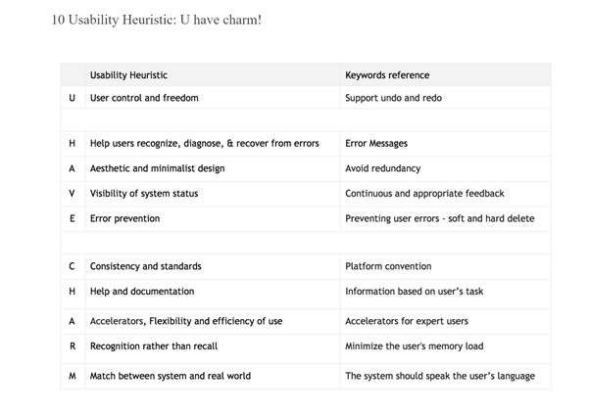
U HAVE CHARM

Slide 4
Your task – part 1:
Watch the videos found below to create a slideshow explaining the 10 heuristics:
Include on each slide:
•1) What's it about
•2) What can a designer do to make sure they meet this heuristic
•3) Give an example of it being done right
•4) Give an example of it being done wrong
•5) What can go wrong if it's not adhered to
Videos: https://www.nngroup.com/videos/usability-heuristic-system-status/

Slide 5
Your task part 2:
Choose 1 website:
Find 2 heuristics they followed well. Write a paragraph on how they have followed each heuristic, how it has made their website more usable and how it has improved the user experience
Find 2 heuristics they have violated. Write a paragraph on how they have violated it, how this is effecting the website's usability and what changes they could make to improve the design of the website.

